Slide 1
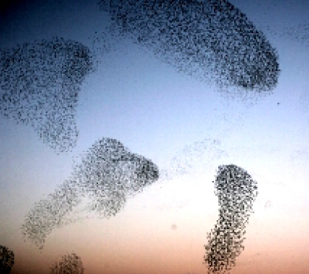
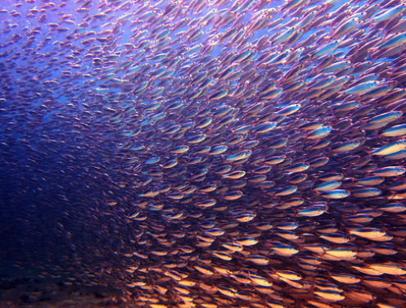
Hyunggyu Park 박 형 규
Starting … Active …

Slide 2
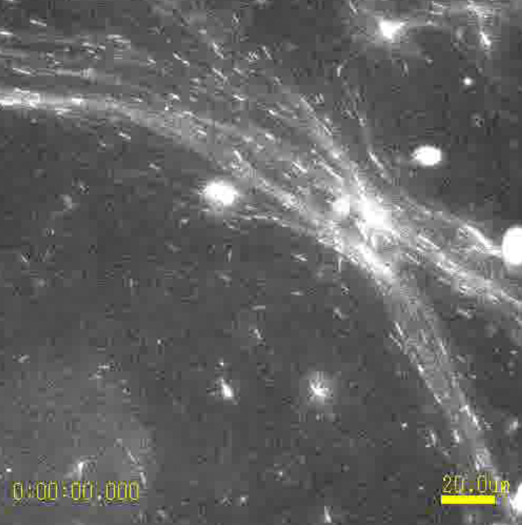
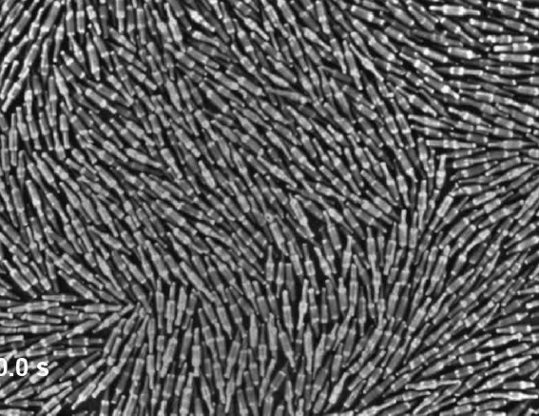
Hyunggyu Park 박 형 규
Starting … Active …

Slide 3
Hyunggyu Park 박 형 규
Active systems
whose dynamics are manifested over a broad spectrum of length and time scales, are driven systems. Because active systems are maintained in non-equilibrium steady states without relaxing to equilibrium, conventional approaches based on equilibrium statistical thermodynamics are inadequate to describe the dynamics.
Nonequilibrium Thermodynamics far from EQ
Fluctuation Theorems
Breakdown of Fluctuation Dissipation Theorems
Active matter
Assemblage of self-propelled particles, which convert energy locally into directed/persistent/non-random motion.

Slide 4
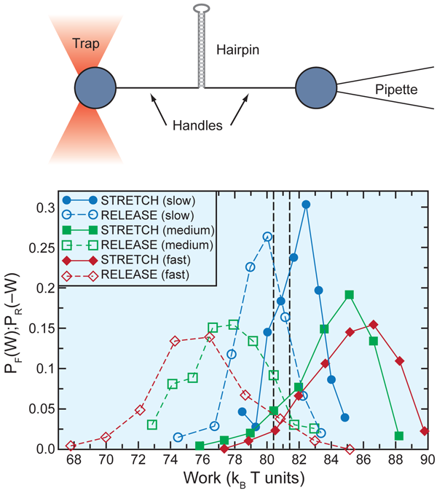
Hyunggyu Park
Introduction to Fluctuation theorems
Nonequilibrium processes
Brief History of Fluctuation theorems
Jarzynski equality & Crooks FT
Experiments
Stochastic thermodynamics
Entropy production and FTs
Ending
2014 summer school on active systems, GIST, Gwangju (June 23, 25, 2014)
[Bustamante]

Slide 5
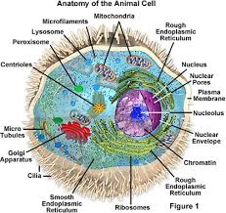
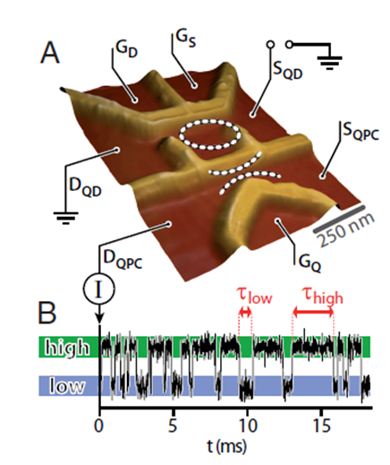
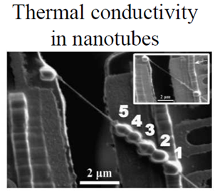
Nonequilibrium processes
Why NEQ processes?
- biological cell (molecular motors, protein reactions, …)
- electron, heat transfer, .. in nano systems
- evolution of bio. species, ecology, socio/economic sys., ...
- moving toward equilibrium & NEQ steady states (NESS)
- interface coarsening, ageing, percolation, driven sys., …
Thermodynamic 2nd law
- law of entropy increase or irreversibility
NEQ Fluctuation theorems
- go beyond thermodynamic 2nd law & many 2nd laws.
- some quantitative predictions on NEQ quantities (work/heat/EP)
- experimental tests for small systems
- trivial to derive and wide applicability for general NEQ processes

Slide 6
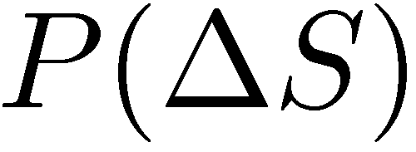
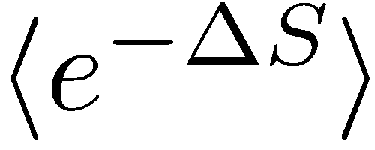
Brief history of FT (I)


Slide 7
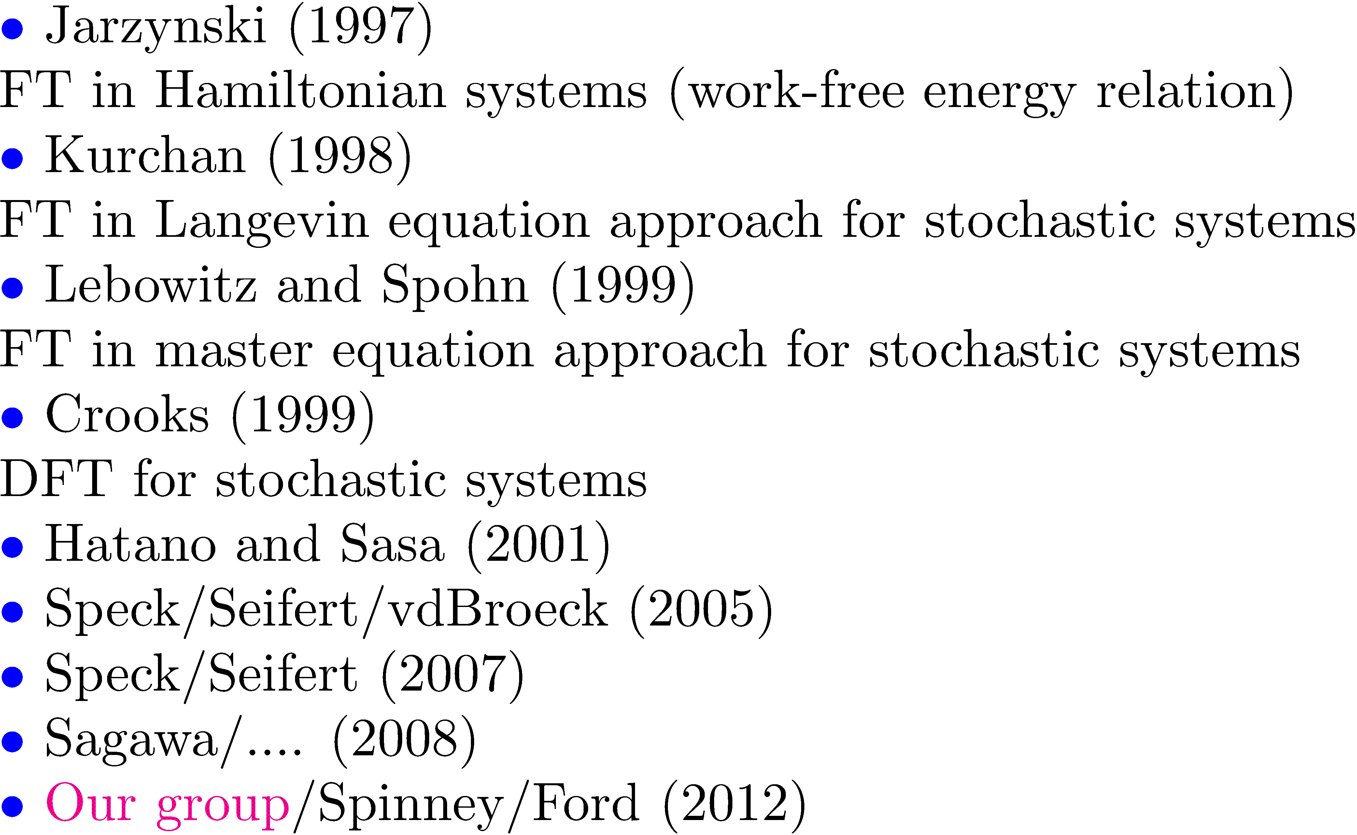
Brief history of FT (II)

Slide 8
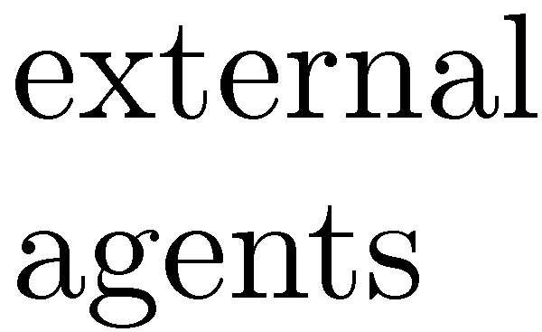
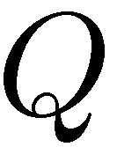
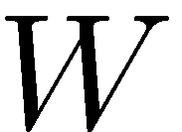
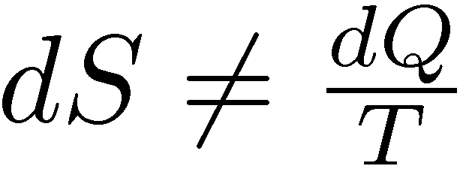
Thermodynamics & Jarzynski/Crooks FT
Thermodyn. 1st law
System
Thermodyn. 2nd law
Phenomenological law
Total entropy does not change during reversible processes.
Total entropy increases during irreversible (NEQ) processes.
▶ Work and Free energy
Jarzynski equality (IFT)
Crooks relation (DFT)

Slide 9
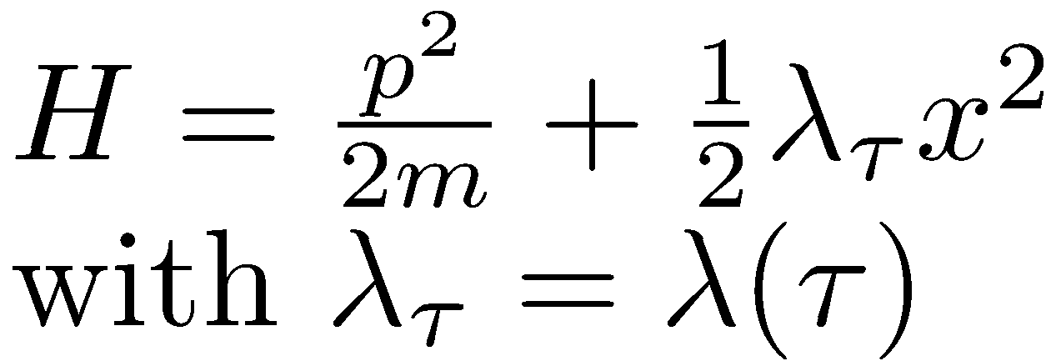
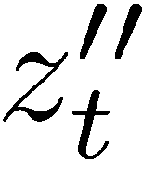
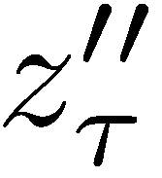
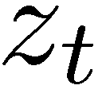
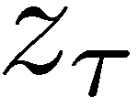
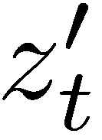
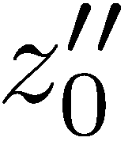
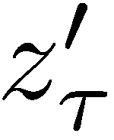
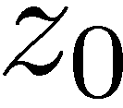
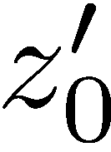
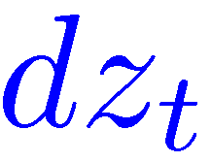
Jarzynski equality & Fluctuation theorems
Simplest derivation in Hamiltonian dynamics
state space
crucial
Intial distribution must be of Boltzmann (EQ) type.
Hamiltonian parameter changes in time. (special NE type).
In case of thermal contact (stochastic) ?
generalized
still valid

Slide 10
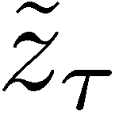
Jarzynski equality & Fluctuation theorems
Crooks ``detailed”fluctuation theorem
odd variable
time-reversal symmetry
for deterministic dynamics
Crooks detailed FT for PDF of Work
``Integral”FT

Slide 11
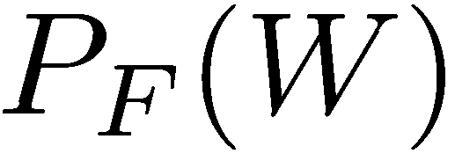
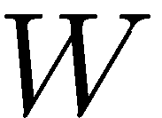
Experiments
DNA hairpin mechanically unfolded by optical tweezers
Collin/Ritort/Jarzynski/Smith/Tinoco/Bustamante,
Nature, 437, 8 (2005)
Detailed fluctuation theorem

Slide 12
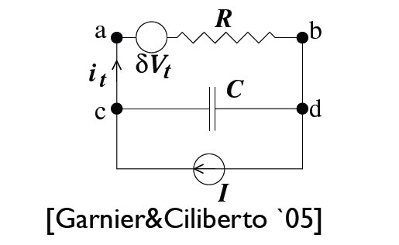
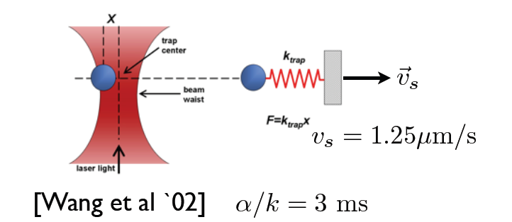
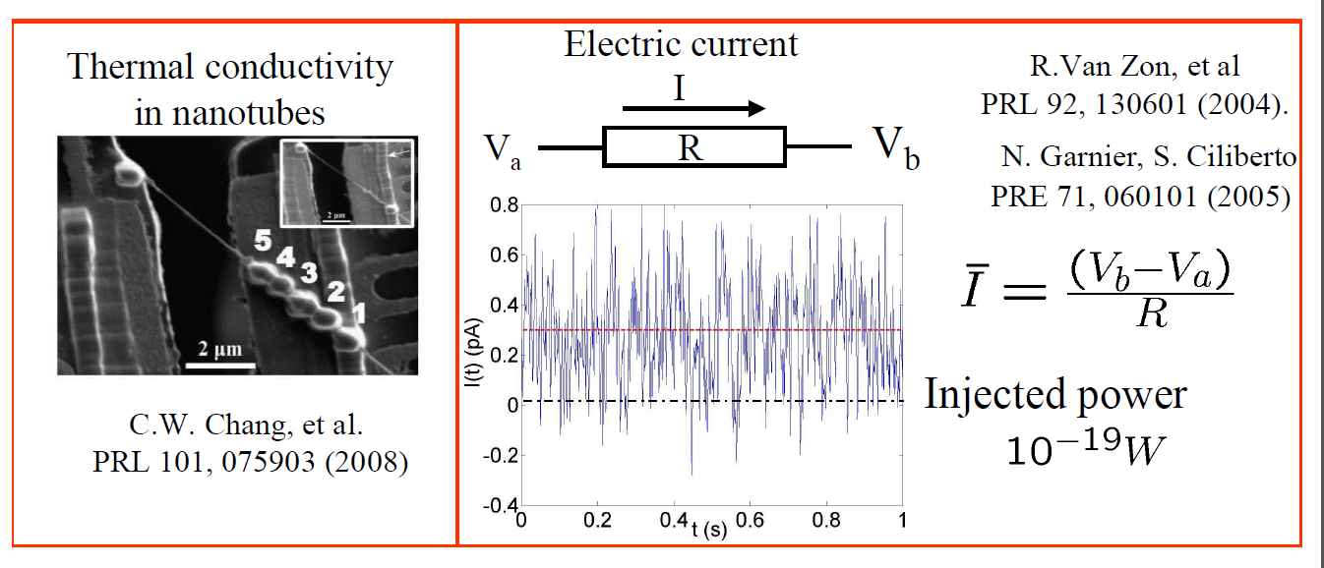

Slide 13
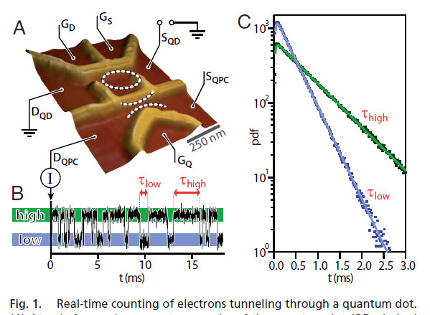
PNAS 106, 10116 (2009)

Slide 14
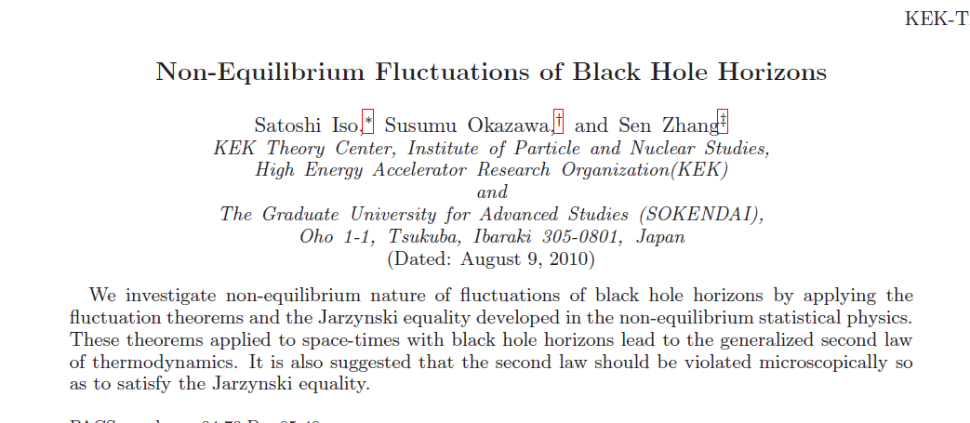
arXiv: 1008.1184

Slide 15
Summary of Part I
Crooks relation
Jarzynski equality
: time-reverse path

Slide 16
Stochastic thermodynamics
Microscopic deterministic dynamics
Stochastic dynamics
Macroscopic thermodynamics

Slide 17
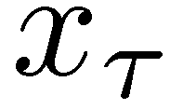
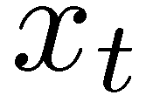
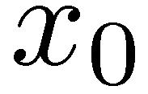
Langevin (stochastic) dynamics
state space
trajectory
System

Slide 18
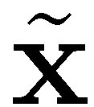
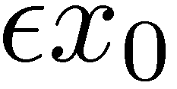
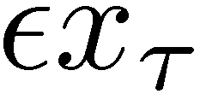
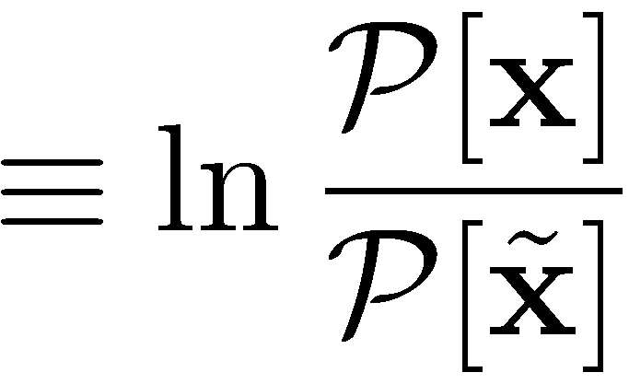
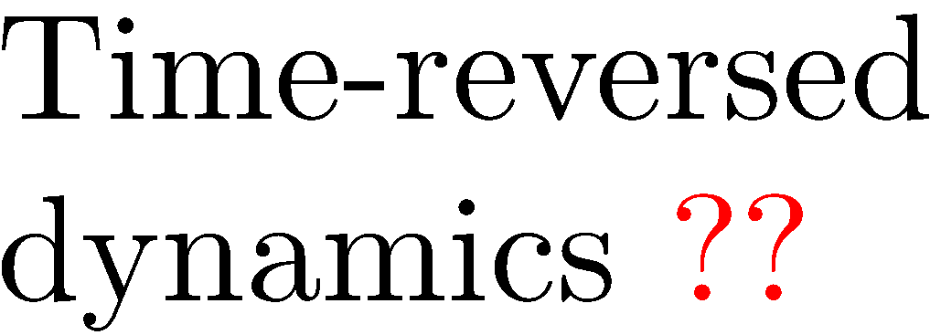
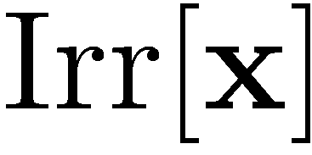
Stochastic process, Irreversibility & Total entropy production
state space
trajectory
time-rev

Slide 19
Total entropy production and its components
System

Slide 20
Fluctuation theorems
System
Integral fluctuation theorems

Slide 21
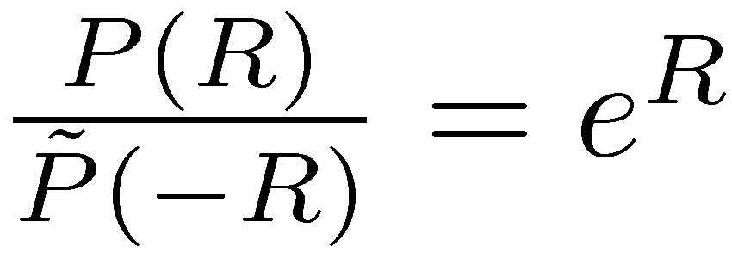
Fluctuation theorems
Integral fluctuation theorems
Thermodynamic 2nd laws
Detailed fluctuation theorems

Slide 22
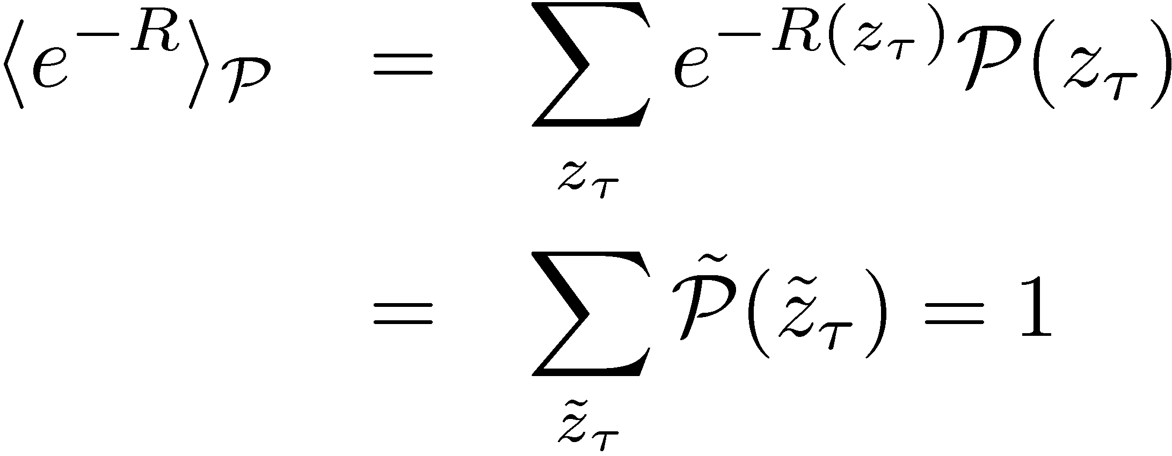
Probability theory
Consider two normalized PDF’s :
state space
trajectory
Define “relative entropy”
Integral fluctuation theorem
(exact for any finite-time trajectory)

Slide 23
Probability theory
Consider the mapping :
Require
reverse path
Detailed fluctuation theorem
(exact for any finite t)

Slide 24
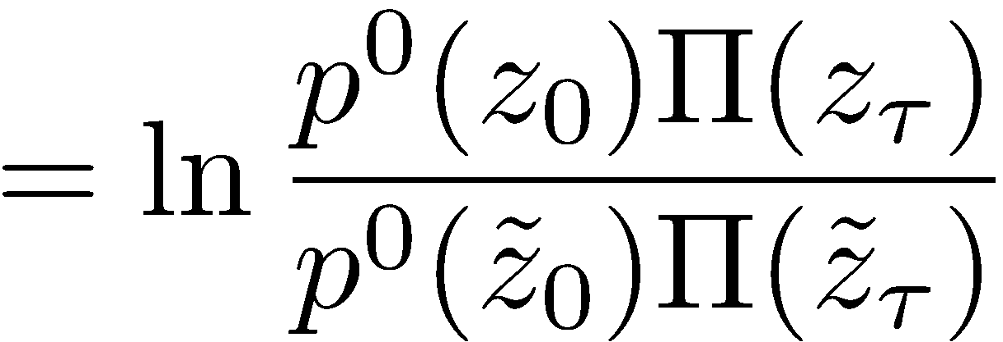
Dynamic processes & Path probability ratio
: time-reverse path

Slide 25
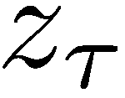
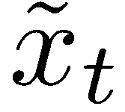
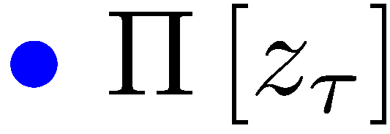
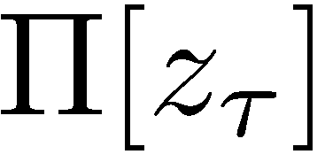
Langevin dynamics
: time-reverse path

Slide 26
Fluctuation theorems
reverse path
Irreversibility (total entropy production)

Slide 27
Fluctuation theorems
reverse path
Work free-energy relation (dissipated work)

Slide 28
Fluctuation theorems
reverse path
House-keeping & Excess entropy production
NEQ steady state (NESS)
for fixed

Slide 29
Dynamic processes with odd-parity variables?

Slide 30
If odd-parity variables are introduced ???

Slide 31
Ending
Remarkable equality in non-equilibrium (NEQ) dynamic processes, including Entropy production, NEQ work and EQ free energy.
Turns out quite robust, ranging over non-conservative deterministic system, stochastic Langevin system, Brownian motion, discrete Markov processes, and so on.
Still source of NEQ are so diverse such as global driving force, non-adiabatic volume change, multiple heat reservoirs, multiplicative noises, nonlinear drag force (odd variables), and so on.
Validity and applicability of these equalities and their possible modification (generalized FT) for general NEQ processes.
More fluctuation theorems for classical and also quantum systems
Nonequilibrium fluctuation-dissipation relation (FDR) : Alternative measure (instead of EP) for NEQ processes?
Usefulness of FT? Effective measurements of free energy diff., driving force (torque), ..
Need to calculate P(W), P(Q), … for a given NEQ process.

